Slide 1
Food Chains of Different Ecosystems
Ms. O’Keefe’s Third Grade Class

Slide 2
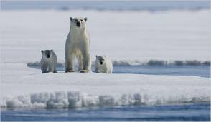
Tundra Food Chain
Sun
Producer moss
Carnivore wolf
Herbivore reindeer
Decomposer mushroom
Jayne

Slide 3
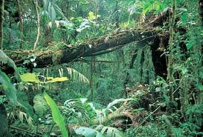
Rainforest Food Chain
Sun
Producer Plant Roots
Herbivore Javelin
Carnivore Jaguar
Decomposer Grub
Russell

Slide 4
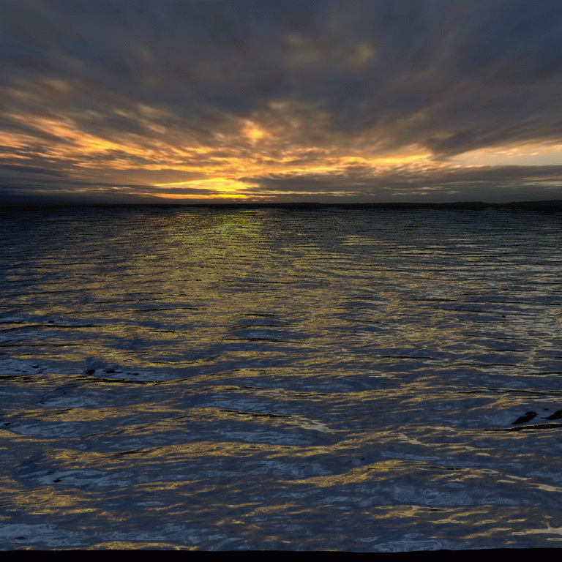
Ocean Food Chain
Sun
Producer Algae
Herbivore Little Fish
Carnivore Seal
Decomposer Moss
Carnivore Shark
Caroline

Slide 5
Ocean Food Chain
Sun
Producer Phytoplankton
Herbivore Zooplankton
Carnivore Fish
Decomposer fungus
Carnivore Seal
Charley

Slide 6
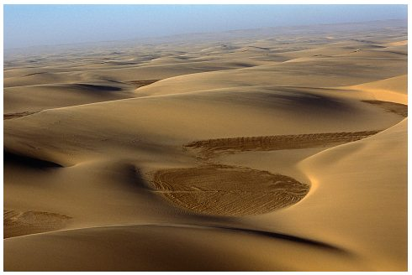
Desert Food Chain
Sun
Producer Cactus
Herbivore Bunny
Carnivore Bobcat
Decomposer Fungus
Carnivore Rattle snake
mia

Slide 7
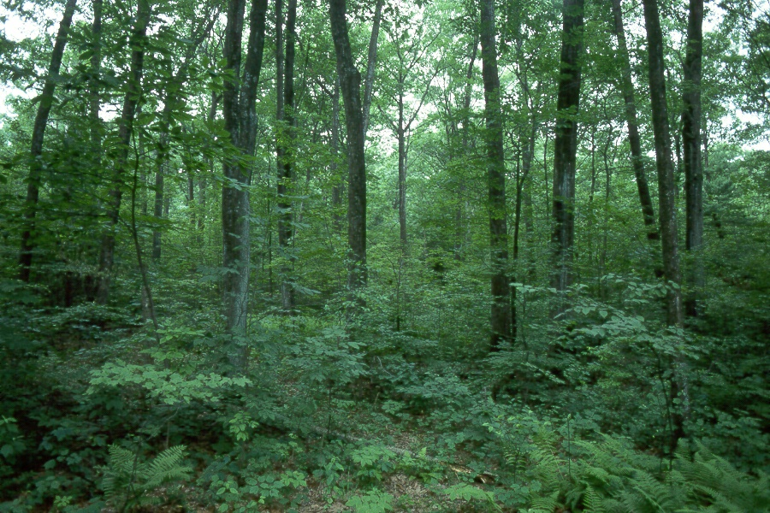
Forest Food Chain
Sun
Producer Fern
Herbivore Bunny
Carnivore Fox
Decomposer Mushrooms
Carnivore Bear
Thomas

Slide 8
Ocean Food Chain
Sun
Herbivore Clam
Decomposer Algae
Carnivore Crab
Producer Kelp
Carnivore Tuna Fish
Justin

Slide 9
Rainforest Food Chain
Sun
Producer fern
Herbivore
tapir
Carnivore
Boa constrictor
Decomposer
mushroom
Carnivore
Cobra
Anabelle

Slide 10
Arctic Food Chain
Sun
Producer
Moss
Herbivore
Arctic Hare
Carnivore
Arctic Fox
Decomposer
Mold
Lucas

Slide 11
Ocean Food Chain
Sun
Producer Phytoplankton
Herbivore Fish
Carnivore Seal
Decomposer Algae
Carnivore Sharks
nina

Slide 12
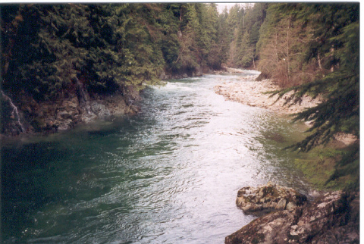
River Food Chain
Sun
algae
tadpole
fish
alligator
fungus
Teddy

Slide 13
Rainforest Food Chain
Sun
Producer Plant Roots
Herbivore grub
Decomposer
mushroom
Carnivore
jaguar
Omnivore
Toucan
Alexander

Slide 14
Rainforest Food Chain
Sun
Producer Plant Roots
Herbivore javelina
Carnivore jaguar
Decomposer Grub
Danielle

Slide 15
Ocean Food Chain
Sun
Producer algae
Herbivore tadpole
Carnivore fish
Carnivore alligator
Decomposer bacteria
David

Slide 16
River Food Chain
Sun
Producer grass
Herbivore Insect
Omnivore Turtle
Decomposer Mushroom
Carnivore Fish
Hidetoshi

Slide 17
Forest Food Chain
Sun
Producer
Fern
Carnivore
fox
Decomposer
Mushrooms
Herbivore
Bunny
Carnivore
bear
Nicole

Slide 18
Ocean Food chain
Sun
Producer Phytoplankton
Herbivore Fish
seal
algae
shark
Jared

Slide 19
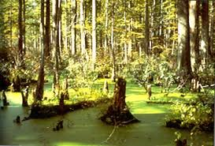
Swamp Food Chain
Sun
Producer Algae
Herbivore Tadpoles
Carnivore Alligator
Carnivore Fish
Decomposer Bacteria
Amanda

Slide 20
Ocean Food Chains
Sun
producer kelp
Herbivore phytoplankton
Carnivore zooplankton
Decomposer fungus
Carnivore seal
Jillian

Slide 21
Rain Forest Food Chain
Sun
Producer Plant Roots
Herbivore Grub (beetle larva)
Carnivore Javelina
Decomposer Mushrooms
Carnivore Jaguar
Sebastian

