Slide 1
Picture from: http://ep.yimg.com/ay/yhst-55227183705516/beach-24.jpg

Slide 2
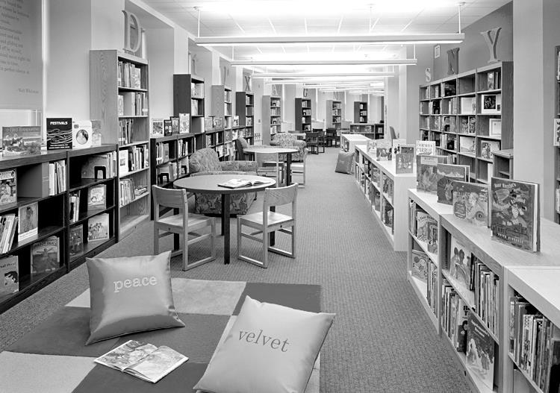
Picture from: http://images.fastcompany.com/upload/beginning-with-children-library.jpg

Slide 3
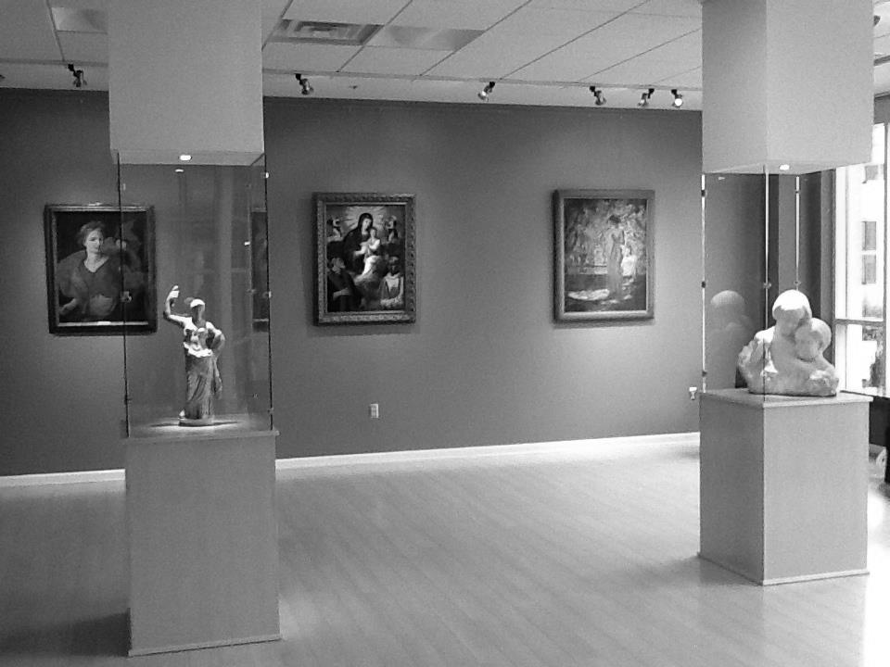
Picture from: http://www.jmu.edu/madisonart/wm_library/Skyline_Museum.JPG

Slide 4
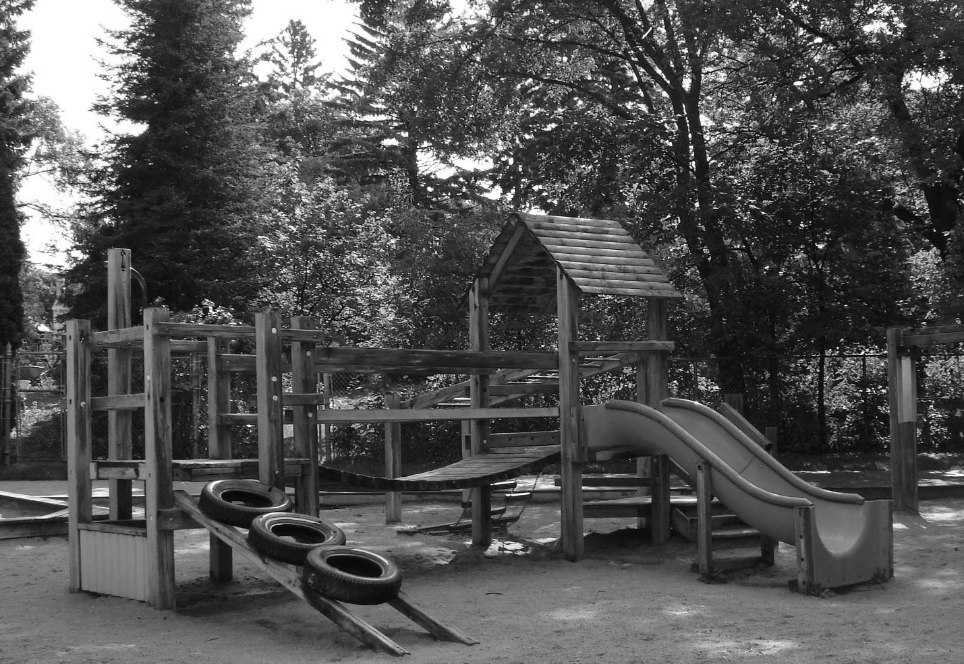
Picture from: http://thinkingmomsrevolution.com/wp-content/uploads/2012/03/bruce_park_playground.jpg

Slide 5
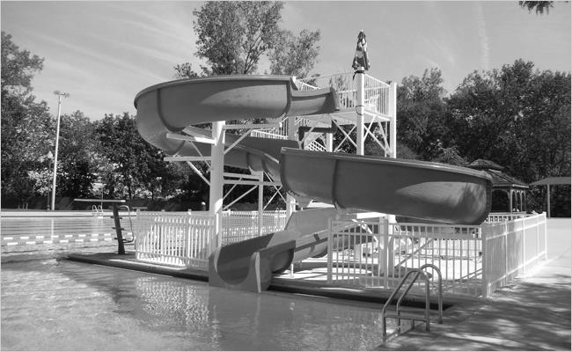
Picture from: http://www.allstatetechnology.com/images/project_paramus_01.jpg

Slide 6
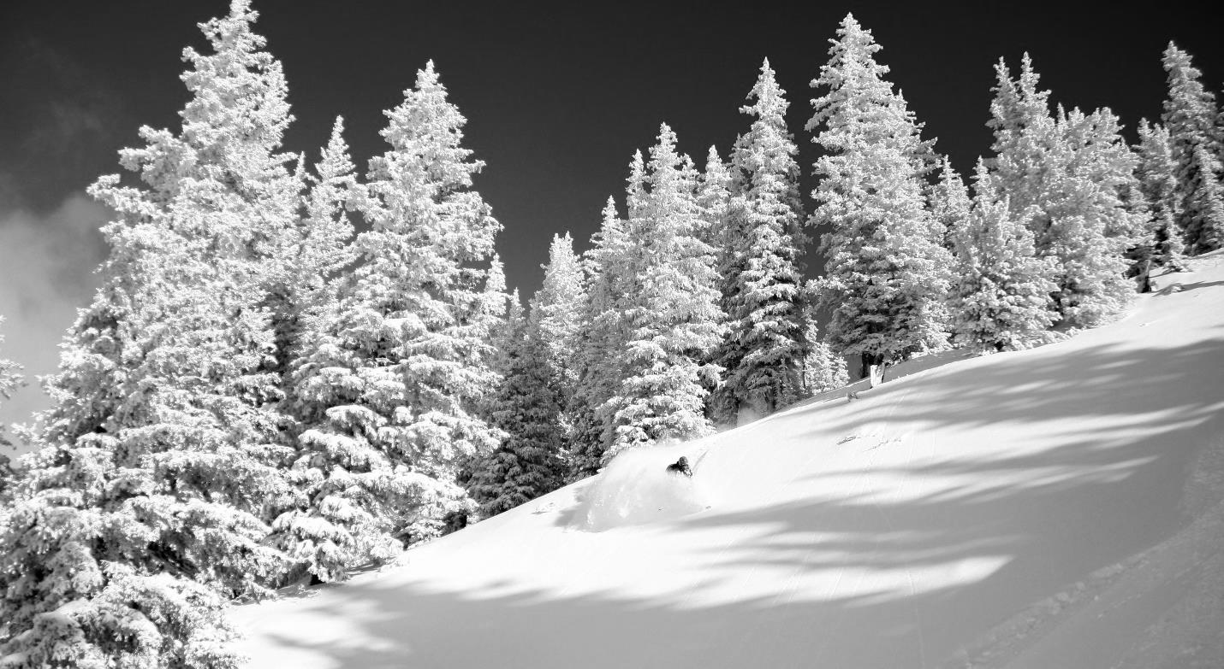
Picture from: http://www.summitpost.org/images/original/677876.JPG

