Slide 1
Be Glad Your Nose is on Your Face Jack Prelutsky, 1940

Slide 2
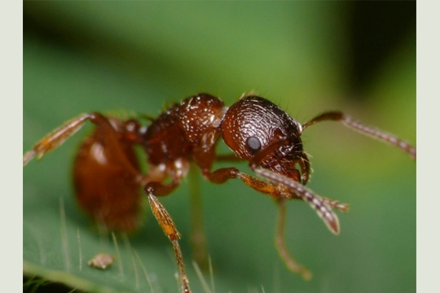
Notes:
http://4.bp.blogspot.com/-T1GZSQHpnug/UAWm5hsgHOI/AAAAAAAAAkc/h0VbIHCFUbM/s1600/ants2.jpg

Slide 3
Notes:
https://farm3.staticflickr.com/2178/2207263529_c986ee59e7_s.jpg

Slide 4
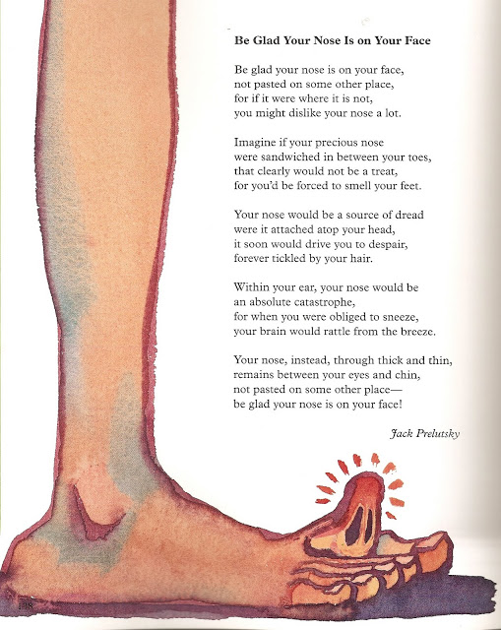
Notes:
http://2.bp.blogspot.com/-snb4PUVNNzM/TXUVSyrL83I/AAAAAAAAK-M/xSDN-eGfVkQ/s640/scan0001.jpg

Slide 5
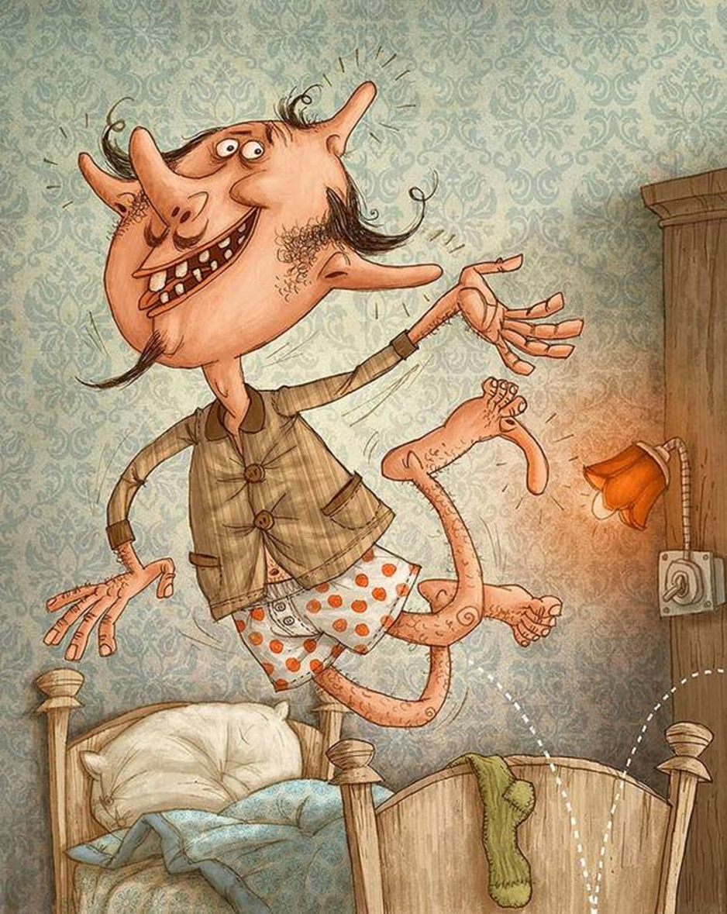
Be glad your nose is on your face,
not pasted on some other place,
for if it were where it is not,
you might dislike your nose a lot.
Imagine if your precious nose
were sandwiched in between your toes,
that clearly would not be a treat,
for you’d be forced to smell your feet.
Your nose would be a source of dread
were it attached atop your head,
it soon would drive you to despair,
forever tickled by your hair.
Within your ear, your nose would be
an absolute catastrophe,
for when you were obliged to sneeze,
your brain would rattle from the breeze.
Your nose, instead, through thick and thin,
remains between your eyes and chin,
not pasted on some other place--
be glad your nose is on your face!
Notes:
http://behance.vo.llnwd.net/profiles15/681918/projects/4154735/eff61617635d34c9f9e45aa763402387.jpg

Slide 6
https://www.youtube.com/watch?v=T9K0DoVMZvs

